Slide 1
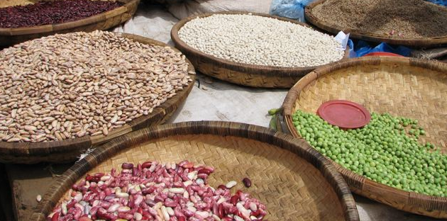
Response Analysis: Approaches and Directions Forward
Christopher B. Barrett and Erin C. Lentz, Cornell University
LRP Learning Alliance
Local And Regional Procurement Learning and Knowledge Workshop
Sponsored by TOPS, funded by USAID Food for Peace
Washington DC, Nov 14, 2011

Slide 2
Changing food assistance policies globally
Shifting from donor-driven to respondent-driven
Increasing donor flexibility
Growing interest in local and regional procurement
Creates choice when responding to food insecurity:
Cash and vouchers
Food procured locally and regionally (LRP)
Transoceanic food aid
Increasing choices means that agencies need better tools to make good choices: response analysis.
Focus on ex-ante analysis. Next session talks about implementation aspects.

Slide 3
Role of response analysis
The form of transfer matters
Tradeoffs among transfer modes
Growing body of evidence that there is no “magic bullet”
Different approaches are better for different objectives
Many of the costs and benefits of the various transfer options are contingent upon market conditions.
Important non-market factors as well
Response analysis
Links need with identified best-bet response
Evidence-based approach
Analyzes likely impact of alternative responses

Slide 4
Response analysis tools
Approaches to market assessments vary by:
Objectives
Approaches
User capacity
Audiences (sometimes)
Major food-security related tools include:
EMMA
WFP’s EFSA and CFSVA
FEWs – Market Assessment and Analysis
FAO’s RAF
MIFIRA (Cornell/Tufts/CARE)

Slide 5
Market Information and Food Insecurity Response Analysis Framework (MIFIRA)
Initially developed by CARE, Tufts, and Cornell and funded by USAID Food for Peace
Has been used by CARE, CRS, FAO, FEWs, ILRI and ReSAKSS
Northern Kenya, Eastern Kenya, and Nairobi
Somalia
Uganda
Afghanistan?
Proof of concept in Malawi, Bangladesh
Trainings at Cornell University, Makerere University, and University of Nairobi
Training materials to be finalized March 2012

Slide 7
Q1. Are local markets functioning well?
1a. Are food insecure households well connected to local markets?
1b. How will local demand respond to transfers?
1c. How much additional food can traders supply at or near current costs?
1d. Do local food traders behave competitively?
1e. Do food insecure households have a preference over the form/mix of aid they receive?

Slide 8
Q2. Is there sufficient food available nearby to fill the gap?
2a. Where are Viable Prospective Source Markets?
2b. Will Agency Purchases Drive up Food Prices Excessively in Source Markets?
2c. Will Local or Regional Purchases Affect Producer Prices Differently than Transoceanic Shipments?

Slide 9
Response Analysis: Moving forward?
What are the factors or challenges that inhibit uptake of response analysis?
Technical capacity of operational agencies
Too resource or time intensive
Sequencing / timing with funding applications
Limited flexibility of transfers from specific donors
Others?
How to operationalize / routinize response analysis?
Many components of response analysis are public goods
Who should complete market analysis? Regional hubs/Clusters/FEWS/3rd party (like current Bellmon)?
Flip side of a Bellmon (long recognized supply-side effects, now consider demand-side too) … so similar legislative requirement?

Slide 10
Thanks for your time!

Slide 11
Scales of Analysis and Complementary Agency Analysis Capacities

Slide 12
How do Managers / Programmers Make Decisions: Situating Response Analysis within the Programming Cycle*
Needs Assessment
Response Analysis
Response
Planning
Program
Implementation
Monitoring and
Evaluation
*Resource appropriateness requires ongoing market analyses

Slide 13
The Programming Cycle: Information Gathering, Planning and Analysis, and Implementation

Slide 14
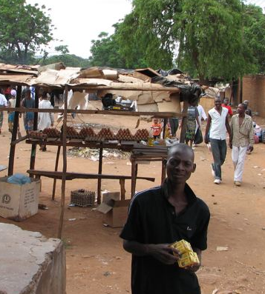
The Form of Transfer Matters
Getting the form of transfer right helps livelihoods…
Households sell food aid - often at a deep discount - to purchase what they need
Yet, when markets are not functioning, cash or vouchers are of limited value.
… and minimizes harm to markets
Impact on markets depends on:
Total amount distributed
Meets needs of households - demand
Seasonality
Type of transfer
Functioning of local market

Slide 15
Comparing Cash and in-Kind Food Transfers
Food transfers generally recommended when: | Cash transfers generally recommended when:
Food intake is prioritized for nutritional purposes (including targeted feeding and micronutrient objectives) Markets do not function well Markets are distant, or during the lean season Inflationary risks are a significant concern Security conditions permit (i.e., food commodities are highly visible) Cash transfer systems do not exist Cost savings is sought through individual / household targeting | Overall humanitarian need, as well as choice and flexibility are prioritized Markets function well Markets are nearby, or during the peak, post-harvest season Production disincentives due to food aid delivery are a significant concern Security conditions permit (i.e., cash is less visible but offers greater incentive for theft) Cash transfer systems exist Cost saving is sought through lower logistical and management overhead

Slide 16
Comparing LRP and Transoceanic Food Aid
LRP risks:
LRP can cause inflationary pressure in source markets
Traders may increase prices, anticipating PVO purchases
Traders may default on tenders
Quality and safety standards may not be met
LRP benefits:
Likely to arrive faster than transoceanic aid
Potential for cost savings
May be able to be timed to arrive during lean season, minimizing production disincentives

Slide 17
“Are local markets functioning well?”

Slide 18
“Is there sufficient food available nearby to fill the gap?

Slide 19
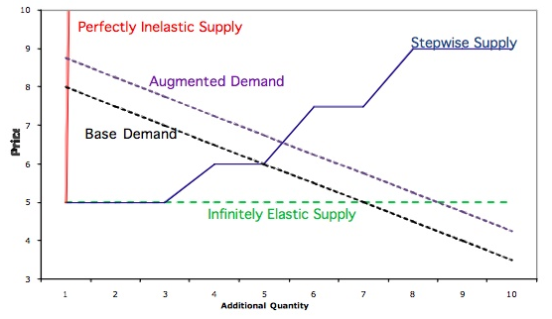
Different Supply Patterns

